Slide 1

Here are some top tips
💙 Talk to your parents or carers about what
helps you at home.
💙 Decide who you want to know that you are
autistic – your parents or carers can help.
💙 Talk to your teachers about what helps you at school.
💙 Remember there is no right way to be autistic and everyone who is autistic is different.
💙 Learn about your brain and how it works.
💙 Celebrate your autistic strengths!
Who else is autistic?
Autism isn’t something you can see just by looking at someone. It is very likely that there are other autistic children at your school or any clubs you might go to.
Here are some famous people that are autistic!
More to Explore:
What is autism?
We are all different from the moment we are born, and we all have a unique brain. If you are autistic, you are born autistic.
Being autistic means that you might experience the world differently to people who aren’t autistic. This doesn’t mean that there is something wrong with you.
It’s really important for the world to have lots of different types of people!
Being autistic doesn’t change
who you are
Knowing you are autistic can help you understand yourself better, like what you’re really good at and what might be harder for you. You are still the same person you were before you knew you were autistic. You’ll keep growing and learning new things, just like everyone else.
Being autistic is just one part of who you are.
Greta Thunberg: Climate activist, campaigning to stop climate change
Sam Holness: Triathlete & Guiness World Record Holder
Lola Blue, Caitlin Hamilton & Georgia De Kidlow: from CBBC show ‘A Kind of Spark’
Sia:
Singer
cypf.berkshirehealthcare.nhs.uk/neurodiversity

Slide 2

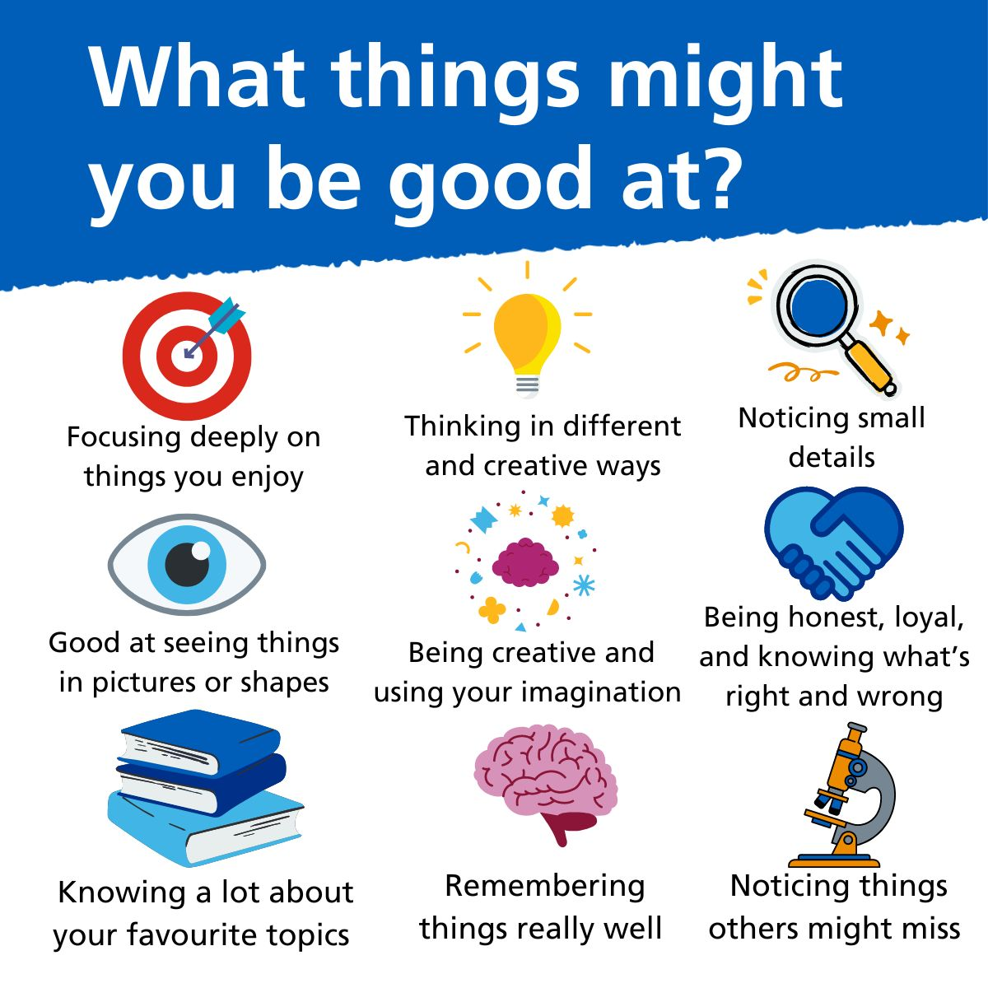
What does it mean to be autistic?
Talking a lot about things you like and sharing lots of facts all at once.
Finding it hard to say what you’re thinking or feeling, and sometimes it’s tough to talk to others.
Liking to have one good friend or a small group of friends, enjoying time alone, and preferring friends who like the same things as you.
Not liking to look people in the eyes, and sometimes not being sure what their faces are telling you.
Wanting to know what’s going to happen next and liking to do things in a certain order.
Moving your hands or body in a way that feels good or helps you.
Noticing things like noises, lights, and how things feel or taste more than other people do.
Spending lots of time on
your favourite hobbies
and things you enjoy.
Each autistic person is different, so some of these things might sound like you, but some of them might not!
The ‘Amazing Things Happen’ video might help your friends or family to understand autism https://amazingthingshappen.tv/?projects=amazing-things-happen
Listen to autistic children describing what it is like to be autistic. https://amazingthingshappen.tv/?projects=amazing-kids-autistic-spectrum-condition
2
3

