Slide 1
Congratulations on your pregnancy and welcome to your
Health Visiting service
www.berkshirehealthcare.nhs.uk

Slide 2
Who are we and what do we do?
Health Visitors are trained nurses and/or Midwives with additional training to work with families with children aged 0-5 years.
We aim to support you to be the best parent that you can for your child.
We work with staff nurses and nursery nurses to provide your local Healthy Child Programme.
We offer different levels of service for families with greater needs.
We work with other health and Early Years professionals to ensure the best outcomes for your child

Slide 3
Your local Healthy Child Programme
Health Visiting Contact Activity
Antenatal
New birth Visit
6-8 week postnatal health review
9-12 month health review
2-2.5 year health review
Transfer in contact
Child health clinic
Duty Health Visitor Line
Additional support
Service Level
Everyone (Universal)
Everyone
Everyone
Everyone
Everyone
Everyone – Open Access
Everyone – Open Access
For those who need more support

Slide 4
Your Personal Child Health Record
(Red Book)

Slide 5
Building a
Happy Baby

Slide 6
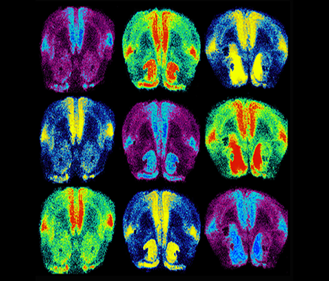
Brain development!
Nature (genes) and nurture (how a baby is looked after physically and emotionally) work together in developing the baby’s brain.
The connections developing in your baby’s brain (which store information) are influenced by the information received from the care that your baby receives and from their environment.
Hormones also affect brain development. Babies release Oxytocin when they feel happy and safe. This has a positive effect on brain development and a child’s confidence and happiness.

Slide 7
Connecting with your baby before birth

Slide 8
How will you help your baby to feel safe and protected and let him know he can trust you?

Slide 9
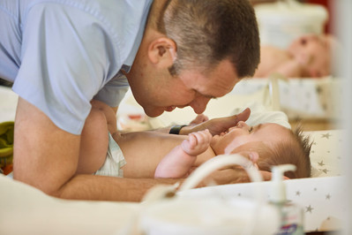
Helping your baby feel happy
and safe
New babies need to be close to their parents. Skin to skin is a great way of building a bond and helping baby to feel secure
When babies feels secure they release Oxytocin. This helps promote brain development and helps baby to feel comforted and happy
Keeping baby close enables parents to recognise signals such as the need to be fed or comforted. You cannot spoil your baby by giving them this attention
When babies’ needs for love and comfort are met they will be calmer and grow up to be healthy, secure children and adults
Babies feel comforted and secure just by looking into their parent’s eyes

Slide 10
Helping your baby’s early development
1-4 weeks
Babies enjoy looking at familiar faces and hearing familiar voices.
Babies can respond to sights and sounds from an early age.
4-6 weeks
Enjoy smiling, talking to and listening to your baby and see their response.
4-12 weeks
Notice how your baby will try to lift their head while lying on their front.

Slide 11
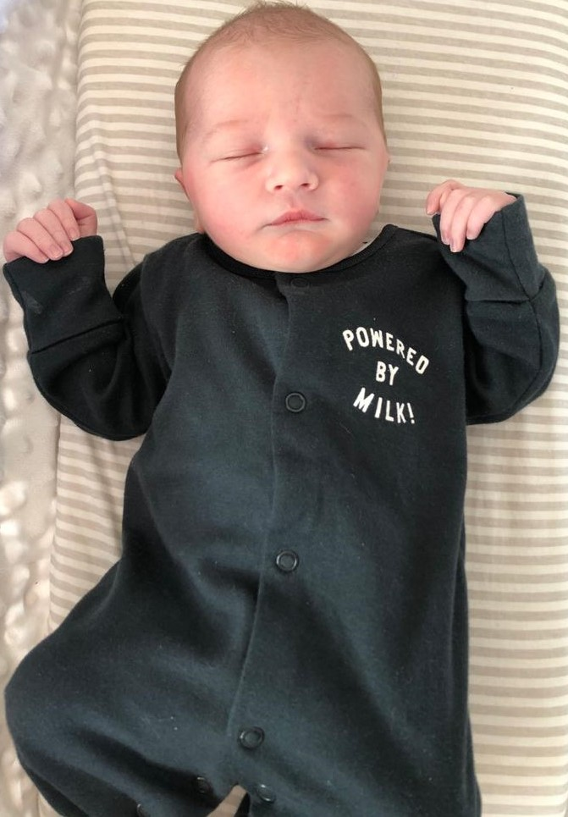
Sleeping like a baby……..
New babies have a different ‘body clock’.
Adults – based on release of hormones associated with sunlight and darkness.
New babies’ sleep is regulated by hunger.
New babies sleep 15 -20 hours in bouts of 2-3 hours (breast milk takes 90 mins to digest).
Sleep divided equally over day and night.

Slide 12
Protecting Your
Baby

Slide 13
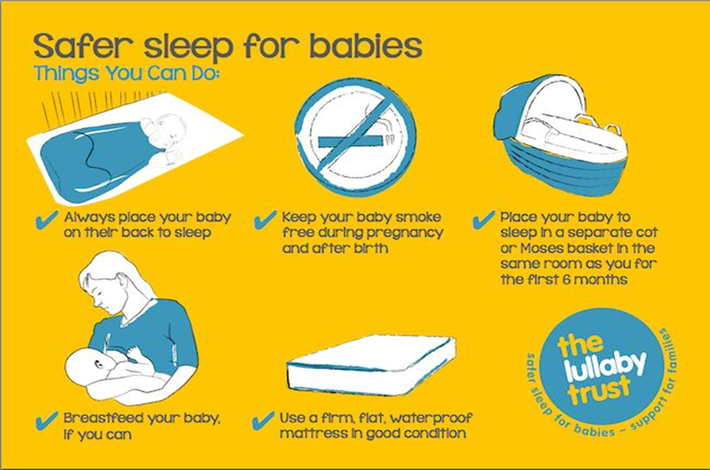

Slide 14
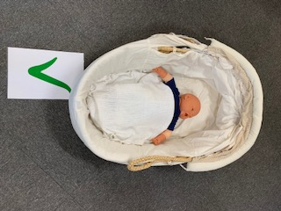

Slide 15
Keeping your baby safe

Slide 16
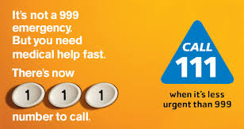
Do you know where to get help
from if you are worried about your baby?
Your local pharmacist can help you with lots of everyday ailments and offer good advice
Your GP can offer urgent appointments each day.
You can get advice and help fast from the 111 service. You can also obtain urgent out of hours GP services.
999 for serious accidents and emergencies.

Slide 17
Parental Well – Being -
Looking After Yourself

Slide 18
Looking after yourself
Having a baby changes your body. Some things may never be quite the same again, but other changes don't need to be permanent.
Any weight you've gained will gradually drop off if you eat healthily and exercise.
Regular activity can relax you, keep you fit and help you feel more energetic.
It's important to look after your mental health as well as your physical health.

Slide 19
Postnatal emotional health
Pregnancy and having a new baby is usually a happy and positive time in a woman’s life.
Having a baby is a life-changing event that can be stressful and exhausting. It often takes time to adapt to becoming a new parent.
Postnatal depression is a common problem, affecting more than 1 in every 10 women within a year of giving birth. It can also affect fathers and partners.
If you notice that you are feeling low, talk about it with your family if you can and contact your health visitor or doctor.

Slide 20
Feeding Your
Baby

Slide 21
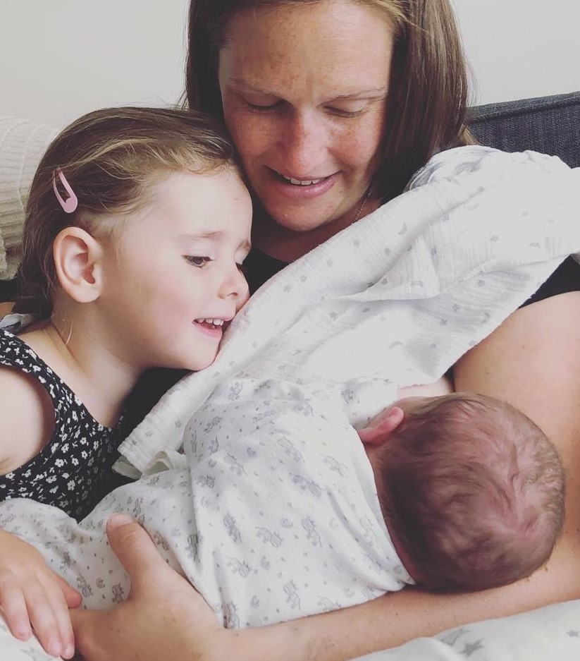
Responsive feeding – what is it?
Feeding when your baby when they show signs of being hungry: look out for cues (moving head and mouth around, sucking on fingers). Crying is the last sign of wanting to feed, so try and feed your baby before they cry
Keeping baby close (day and night)
Follow baby’s cues for when they need a break
Allow your baby to take as much or as little as they want

Slide 22
What does breastfeeding help
protect against?
Every day counts!
Breast feeding can help protect your baby from;
Diarrhoea and vomiting, chest infections and ear infections – hospital admission
Constipation
Developing obesity and type 2diabetes and other illnesses later in life•
Allergies and developing eczema
The longer your baby is breast fed, the greater the protection.
Breast feeding has benefits for you too
reduced risk of breast and ovarian cancer
Reduces risk of hip fractures and heart disease
Uses 500 calories per day
Save up to £45 per month

Slide 24
Soon after your baby is born
Holding your baby against your skin will calm your baby, steady his breathing and help to keep him warm.
This is a great time to start your first breastfeed because your baby is likely to be alert.
Keep your baby close to you and feed him whenever he is hungry, needs comfort or when you want to This will help your body to produce plenty of milk.

Slide 25
Positioning and Attachment Video

Slide 26
How do I know my baby is getting enough milk?
Frequent wet and dirty nappies
Your baby will seem calm and relaxed during feeds
Your baby will be satisfied and content after most feeds
Your baby will be gaining weight
Your breasts feel softer after feeds

Slide 27
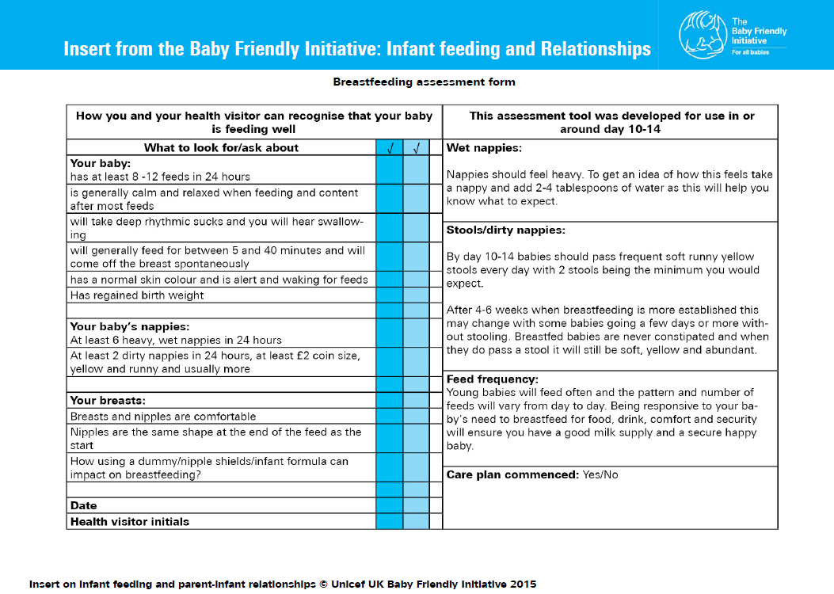
UNICEF baby friendly breastfeeding assessment tool

Slide 28
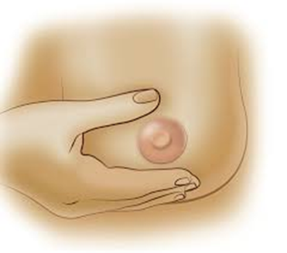
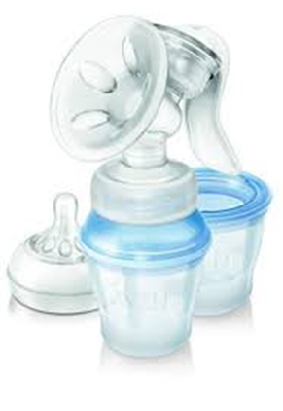
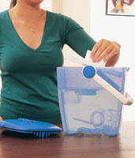
Expressing, storing and sterilising
Did you know that you can express your breast milk and store it in the fridge (5 days – not in the door) or freezer (6 months).
You can express breast milk by hand or with a pump.
There are several ways you can sterilise your baby’s feeding equipment.

Slide 29
Hand Expressing video
Tap on the image to watch the video
Tap here to watch the video on YouTube
or search for UNICEF UK Baby Friendly Initiative Hand Expression

Slide 30
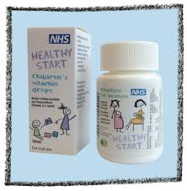
Does your baby need Vitamin D?
Pregnant and breastfeeding mums should take 10 micrograms of vitamin D daily.
All breastfed babies from birth to one year of age should be given a daily supplement containing 8.5-10mcg.
Formula-fed babies do not need vit D unless they are having less than 500ml of infant formula a day, as infant formula is fortified with vitamin D.
Children from the age of one year and adults need 10mcg of vitamin D a day

Slide 31
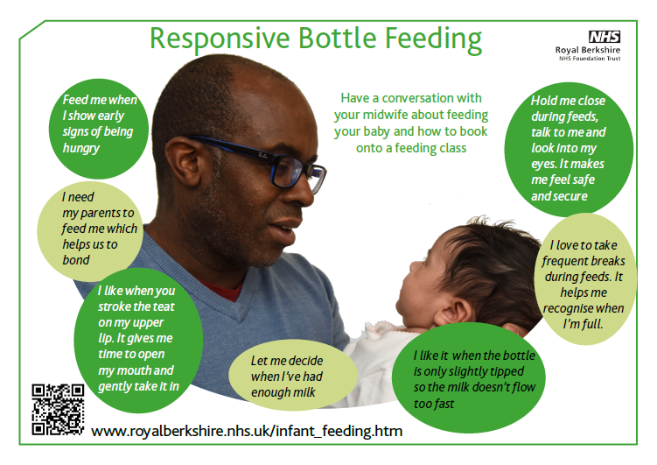

Slide 32
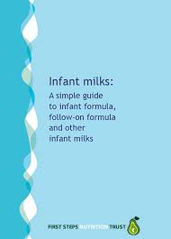
What do parents who plan to
formula feed need to know?
A first formula should always be the first formula milk you give your baby.
Unless advised by a midwife, health visitor or doctor you do not need to change your baby’s milk.
There is no evidence that ‘hungrier’ baby milk has helps a baby to settle or sleep for longer.
There are many different brands of infant formula milk. They are all very similar.
For more information visit firststepsnutrition.org

Slide 33
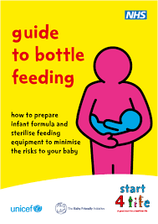
What do parents who plan to
formula feed need to know?
Babies formula feeding equipment must be sterilised until your baby is 12 months old
Always follow the manufacturers guidelines on the side of the formula milk
Every formula feed should be made up individually as your baby needs it
Bottled water is not recommended to make up formula feeds

Slide 34
Where can you get help with feeding?
Midwives, Health visitors,
Information service for parents www.nhs.uk/InformationServiceForeParents
Start for Life – Off to the best start
NHS Choices.uk
Baby Buddy App http://www.bestbeginnings.org.uk/babybuddy
A simple, up to date guide on infant milks firststepsnutrition.org
UNICEF UK guide on different types of infant milks, at babyfriendly.org.uk
Health visitor helpline 9am to 4.30pm. 03003033944

Slide 35
References
DH (2009) Healthy Child Programme – Pregnancy and the first five years. London, DH.
Millpond Children’s Sleep Clinic (2005) Teach your child to sleep, London, Hamlyn
NHS Choices (2016) Postnatal Depression http://www.nhs.uk/conditions/postnataldepression/Pages/Introduction.aspx
NHS Choices (2017) Breastfeeding: is my baby getting enough milk? https://www.nhs.uk/Conditions/pregnancy-and-baby/Pages/breastfeeding-is-baby-getting-enough-milk.aspx
Oxford Vaccine Group at http://vk.ovg.ox.ac.uk/faqs-about-vaccines
Solihull Approach (2012) Understanding your child’s behaviour http://www.solihullapproachparenting.com/uploads/images/file/brain-development-web-leaflet.pdf
Start4life-off to the best start. www.clch.nhs.uk/media/.../Start4life_to_the_best_Start_leaflet.pdf
The Lullaby Trust - Safer sleep for babies, Support for families https://www.lullabytrust.org.uk
UNICEF United Kingdom (2012) Building a happy baby, a guide for parents http://www.unicef.org.uk/Documents/Baby_Friendly/Leaflets/building_a_happy_baby.pdf
Vaccination Schedule-Vaccinations-NHS Choices. www.nhs.uk/.../vaccinations_vaccination_schedule_age_checklist.aspx.

